Slide 1
Introduction to Linux Systems Inter-Process Communication (IPC)
Chia-Heng Tu
Dept. of Computer Science and Information Engineering
National Cheng Kung University
Fall 2024
Courtesy of

Slide 2
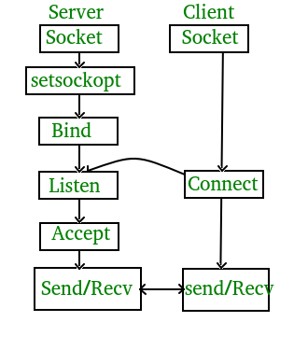
Mini project: Socket Programming in C
https://www.geeksforgeeks.org/socket-programming-cc/
Client:
Hello message sent
Hello from server
Server:
Hello from client
Hello message sent

Slide 3
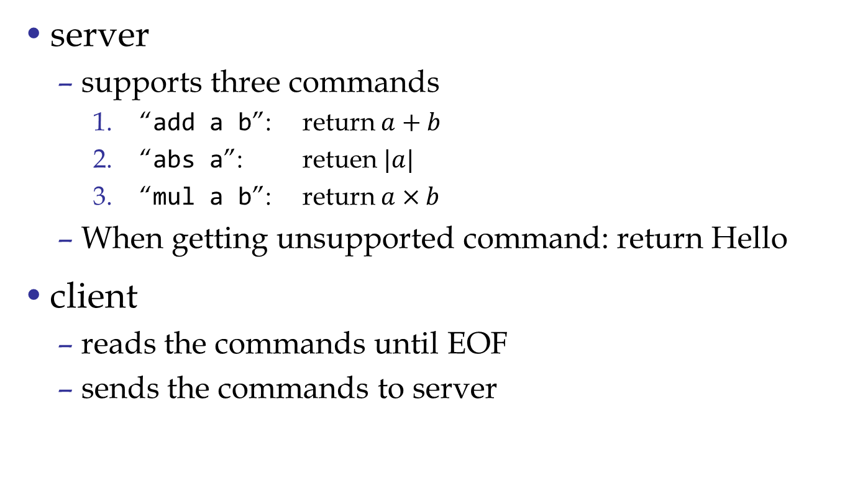
IPC using simple socket
supports command kill

Slide 4
Execution flow (supported)
client
server
stdin
"add 1 2\n"
"3\n"
stdout
stdin
"kill\n"

Slide 5

Execution flow (unsupported)
client
server
stdin
"rm -rf/\n"
"Hello\n"
stdout
stdin
"kill\n"
https://star.setn.com/news/851769

Slide 6
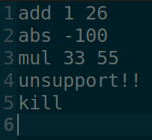
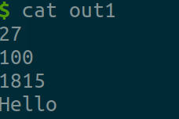
You should pass 4 tasks (60pt)
Input 檔案最後一行是空的
拿回來的答案包含換行

Slide 7
Test by yourself
This also how we test your program
Sample of Makefile:
all: result1 result2
.PHONY = clean result1 result2
result1: file1
WHAT_YOU_WANT_TO_DO
result2: file2
WHAT_YOU_WANT_TO_DO
clean:
HOW_TO_CLEAN(hint:rm)
ans file is provided in ans.zip
$ make
$ ./server & ./client < in > out
$ diff -s out ans
if your output is correct, you will get
“Files out and ans are identical”
Hint: you can add some delay in client to avoid random connection error

Slide 8
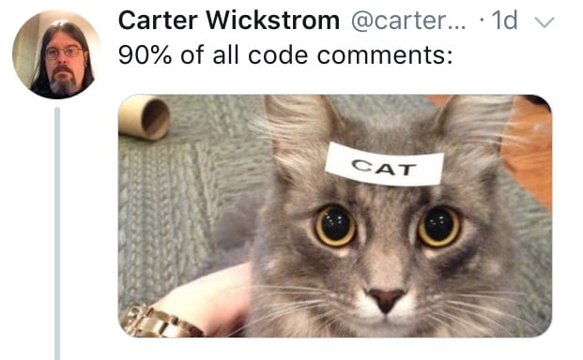
Operation process and comments (40pt)
Clear, Simple, and Useful
Comments in source code
This will be scored by demo video
(video should not exceed 3 min)

Slide 9
Submission
Upload F12345678.zip to moodle
F12345678 is your Student ID
F12345678.zip
└──心得.txt
└── F12345678/
├── in
|── ans
├── client.c
├── server.c
├── Makefile
── Demo.mp4
繳交不符合規定扣 10 分

